Slide 1
COVID-19 Data Analysis
By Md Reazul Islam, Ricardo Villarreal, Tomy Tran

Slide 2
Background & Motivation
The recent global pandemic known as COVID-19 has been causing mass hysteria, city wide shutdowns and a high death toll.
Data mining is a process which incorporates knowledge of computer science and statistics to analyze large observational datasets.
Our goal is to use various data mining techniques and algorithms to extract useful information and patterns from US COVID-19 dataset.
Such information is vital to help us tackle this global pandemic and shift our resources in an efficient manner

Slide 3
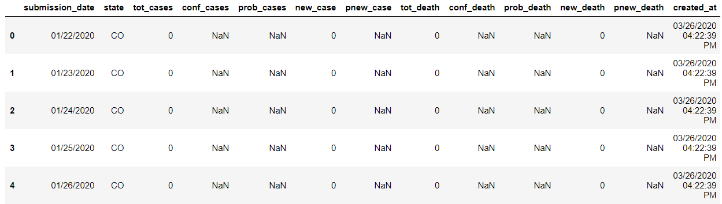
Dataset Description
The dataset, collected from CDC website, contains information on the number of cases and deaths from COVID-19 over a period of time in the United States. There are 15 features in total and 15780 data points. The dates of each state are from 01/11/2020 to 10/10/2020, which is 263 days. There are 60 unique values for the column states (50 US states and 10 US Territory and Possessions such as AS – American Samoa, GU – Guam, MH – Marshall Islands, etc.

Slide 4
Data Preprocessing
In the first few days of each state there are quite a few NaN values. The reason is probably because since those days were early in the pandemic, the data was either not collected or the data was very less.
Since all the NaN values are only in the first few days, so it is reasonable to replace the NaN values with 0. We use df.fillna(0) to fill the null values.

Slide 5
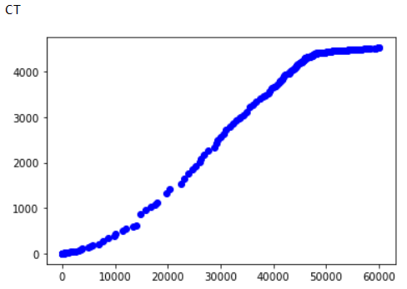
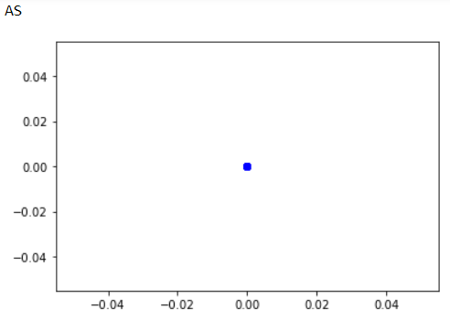
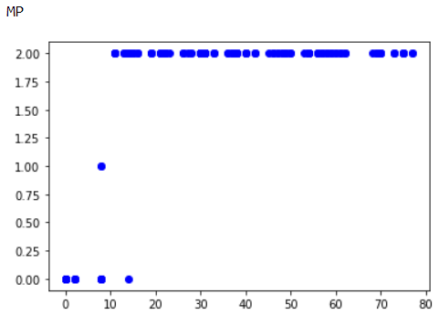
Data Preprocessing
The figures above are the plots of total cases vs total deaths. The left figure is normal and most of the 50 states are similar. The 10 additional states have either extremely small data points or unusual plot as shown on the two figures in the right. So, we remove the 10 additional states from all the future analysis of the of the dataset.

Slide 6
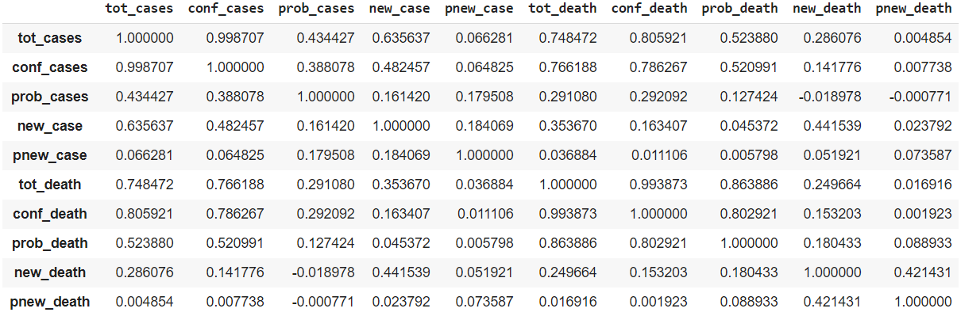
Correlation Matrix
The correlation matrix shows how much each variable is correlated to the others. Most of our features are not highly correlated to each other.

Slide 7
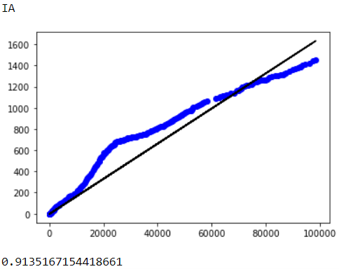
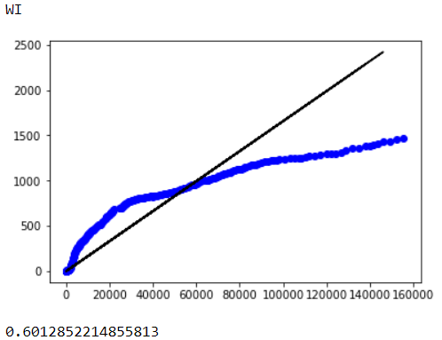
State-wise Linear Regression
To understand and predict how the number of deaths change as cases increase, we fit a linear regression model to each of the different states. We also calculate the R_squared score of each model to determine how well each model performs on the test set.
Some states are able to fit the data quite well on a straight line and have an accuracy of over 90 percent.
However, the score in many states are not satisfactory the trend seems to better fit a polynomial curve rather than straight line. So, we fit a polynomial curve instead of a straight line.

Slide 8
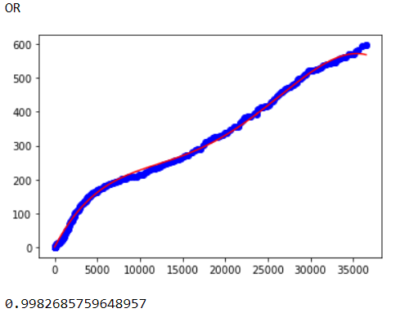
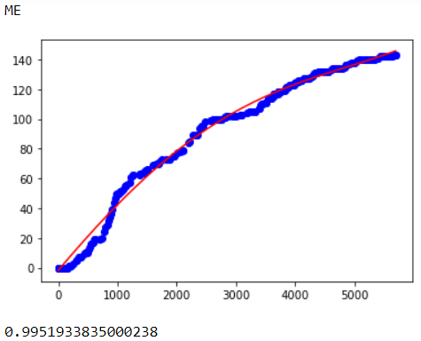
State-wise Polynomial Regression
From the graphs above, it is clearly visible that the polynomial models fit much better than straight lines. We calculated the R_squared error of each of the models for the test set. Almost all of the states have an accuracy of over 95%.
Hence, the polynomial regression models can provide an accurate prediction of how the deaths are expected to change as cases rise in each state.

Slide 9
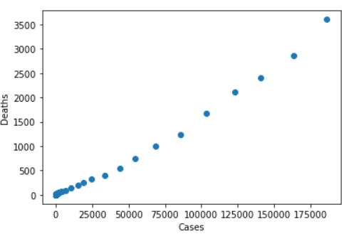
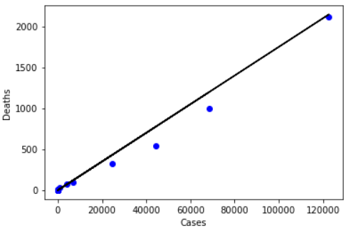
Combined Linear Regression of US
In the next step, we sum all the cases and all the deaths on each day of different states. So, now we have the cases and deaths for the 263 days period of the US. We then perform Linear Regression since the data looks good enough to fit a linear model. The test set accuracy of the regression model is 98% which is pretty good.

Slide 10
Cross Validation
Although we use split the data into training set and test set whenever we fit a model, it is imperative to validate the performance of our models with some more reliable and robust methods. So, we use K-Fold cross validation method to validate our models.
All of the models showed good results with over 90% accuracy. We used k-fold cross-validation with k = 10 (10 folds) on the linear regression model that we fit on the overall US data. The average accuracy was 95.7% and the standard deviation was 3.9.

Slide 11
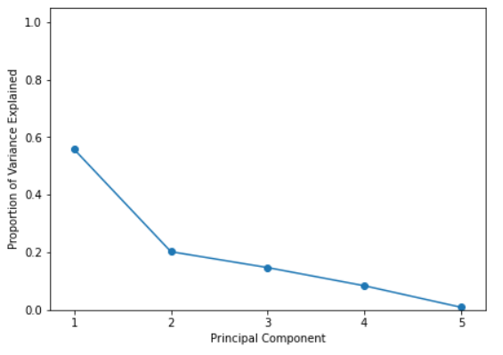
Principal Component Analysis
We also perform Principal component analysis using all the features except the dates to facilitate visualizations in the future. From the graph on the right, we can see that about 80% of the information is retained in the first two principal components. So the PCA performed well to reduce the number of variables and retain most of the informations at the same time.

Slide 12
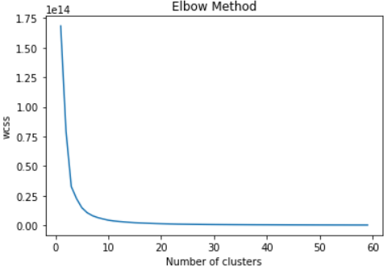
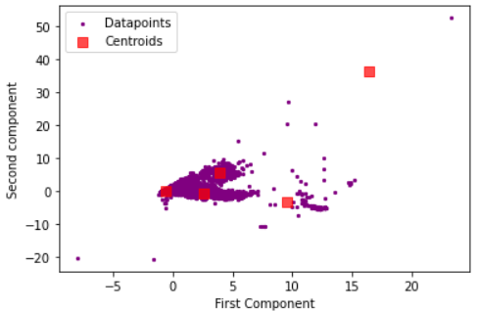
Clustering
We try to perform k-means clustering on the dataset to see if there exists any visible clusters or obvious separation between data points. We use the elbow method to determine the number of clusters. From the elbow curve it seems that 5 clusters is a good choice.
We plot the diagram in a scatter plot using the two components calculated using PCA and also plot the centroids on the same plot. It seems like in higher dimensions the data points might be in clusters but the relationship is not obvious in 2 dimension, so we could not conclude any useful information from clustering results.

Slide 13
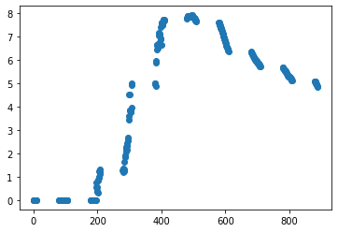
Death Rate Percentage (y) By Month (x)

Slide 14
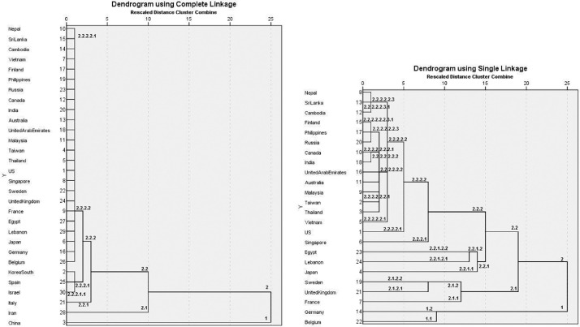
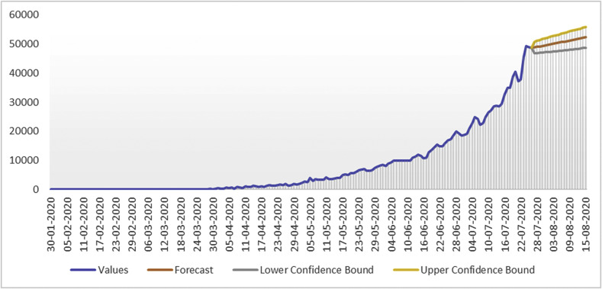
Related Work
(Left) the graph shows us the daily cases of Covid-19 on the daily basis Using Multilple Linear Regression. They model the relationship using Recovered and deceased cases to predict daily cases of Covid-19 in India.
(Right) The graphs shows us the advancements of cases and the clustering of countries on a daily basis. Left: all countries with the data of the 45 first days. Right: clustering after the exclusion of the 6 bottom countries of the left figure.

Slide 15
Future work
To further extend the analysis, the geographic locations of each state will could be collected.
The latitude and longitude information is vital to demonstrate how the the virus is spreading and what regions it has affected the most.
The cases could be clustered using k-means according to the geographic data could provide useful visualizations.

Slide 16
Conclusion
In this study, we implemented various data mining techniques and algorithms on a Covid-19 dataset of US. We first implemented linear regression to be able to predict how cases are rising in individual states as well as US as a whole. The results showed that linear regression was not a good way to fit the data. The visualizations showed that a polynomial curve will fit the data much better, so we then fit polynomial models to the data.

Slide 17
Thank You Questions?

